Slide 1

Quality Assessment

Slide 2
Quality
Assessment
Guide

Slide 3
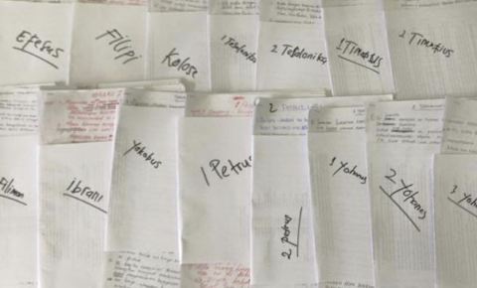



Is it ready?
Keyword
Check
Self-edit
Peer-edit
Quality
Naturalness
Standard
Local Church

Slide 4
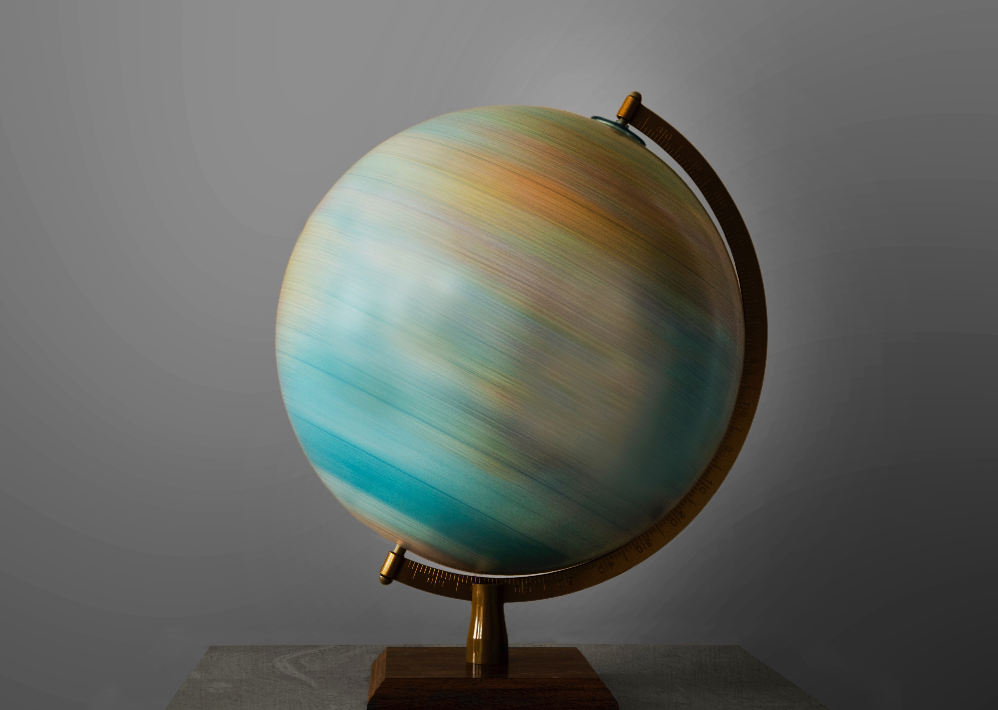
Globally
Accepted Qualities

Slide 5

What makes a good translation?

Slide 6
Try it
Build your guide

Slide 7
Quality Assessment Guide
Qualities
Definitions
Questions
Accurate
Faithful
Historical
Clear
Natural
Correct style
Grammar is correct
Other qualities
________________
________________
________________
________________
________________
________________
________________
________________
________________
________________
________________
________________
________________
________________
________________
________________

Slide 8
Quality Assessment Guide
Example
Yes | No
Accurate
Faithful
Historical
Clear
Natural
Correct Style
Grammar is Correct
Which quality is missing in this sample draft?
Source text (ULB)
(from Matthew 24)
Sample Draft
28 Wherever a dead animal is, there the vultures will gather.
20 Pray that your flight will not occur in the winter or on a Sabbath.
15 "Therefore, when you see the abomination of desolation, which was spoken of by Daniel the prophet, standing in the holy place" (let the reader understand),
28 Wherever a dead animal is, there the ospreys will gather.
20 Pray that your flight will not occur during extremely cold or hot weather, or on a Sunday.
15 "Therefore, when you see the abomination of desolation, which was spoken of by Belteshazzar the prophet, standing in the holy place" (let the reader understand),

Slide 9
Quality Assessment Guide
Example
Yes | No
Accurate
Faithful
Historical
Clear
Natural
Correct Style
Grammar is Correct
Which quality is missing in this sample draft?
Source text (ULB)
(from Matthew 24)
Sample Draft
17 let him who is on the housetop not go down to take anything out of his house,
18 and let him who is in the field not return to take his cloak.
17 let not him who on the top of his dwelling place is go down to take any object out of the dwelling place belonging to him,
18 furthermore let not him who is in the field return to retrieve the outer garment belonging to him.
(These errors may also hinder clarity and style.)

Slide 10
Quality Assessment Guide
Example
Yes | No
Accurate
Faithful
Historical
Clear
Natural
Correct Style
Grammar is Correct
Which quality is missing in this sample draft?
Source text (ULB)
(from Matthew 24)
Sample Draft
19 But woe to those who are pregnant and to those who are nursing infants in those days!
20 Pray that your flight will not occur in the winter or on a Sabbath.
19 But woe to those who are pregnant and to those with small children in those days because of the difficult journey!
20 Pray that your flight will not occur during extremely cold or hot weather, or on a Sabbath.

Slide 11
Quality Assessment Guide
Example
Yes | No
Accurate
Faithful
Historical
Clear
Natural
Correct Style
Grammar is Correct
Which quality is missing in this sample draft?
Source text (ULB)
(from Matthew 24)
Sample Draft
27 For as the lightning shines out from the east and flashes all the way to the west, so will be the coming of the Son of Man.
27 For as light quickly shines across the sky from the east all the way to the west, so will be the coming of the Son of Man.

Slide 12
Quality Assessment Guide
Example
Yes | No
Accurate
Faithful
Historical
Clear
Natural
Correct Style
Grammar is Correct
Which quality is missing in this sample draft?
Source text (ULB)
(from Mark 1)
Sample Draft
4 John came, baptizing in the wilderness and preaching a baptism of repentance for the forgiveness of sins.
4 John came, baptizing
in the wilderness
and preaching a baptism
of repentance
for the forgiveness of sins.

Slide 13
Quality Assessment Guide
Example
Yes | No
Accurate
Faithful
Historical
Clear
Natural
Correct Style
Grammar is Correct
Which quality is missing in this sample draft?
Source text (ULB)
(from Mark 1)
Sample Draft
1 The beginning of the good news about Jesus the Messiah, the Son of God
5 The whole country of Judea and all the people of Jerusalem went out to him. They were baptized by him in the Jordan River, confessing their sins.
1 The beginning of the good news about Jesus the Messiah, the Beloved of God
5 The whole country of Judea and all the people of Jerusalem went out to him. They were sprinkled by him in the Jordan River, confessing their sins.
(Notice that errors in faithfulness can also compromise accuracy and clarity.)

Slide 14
Quality Assessment Guide
Example
Yes | No
Accurate
Faithful
Historical
Clear
Natural
Correct Style
Grammar is Correct
Which quality is missing in this sample draft?
Source text (ULB)
(from Mark 1)
Sample Draft
6 John wore a coat of camel’s hair and a leather belt around his waist, and he ate locusts and wild honey.
6 John wore a coat of camel’s hair and a leather belt around his waist, and he eats locusts and wild honey.

Slide 15
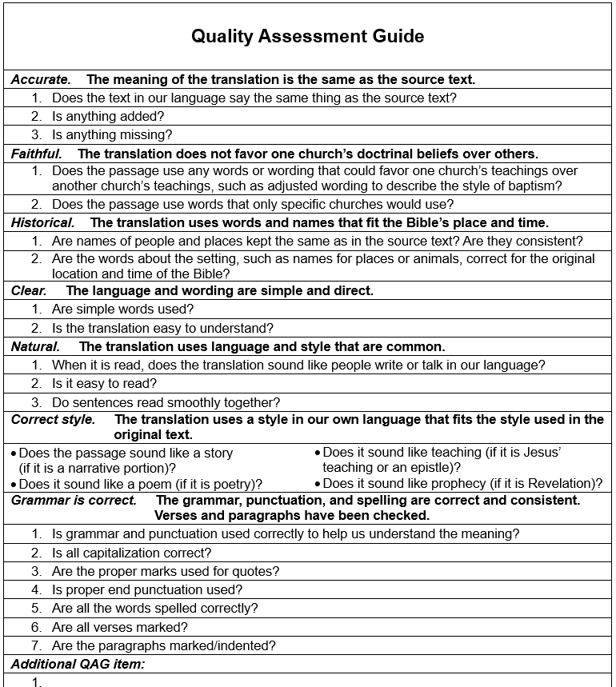
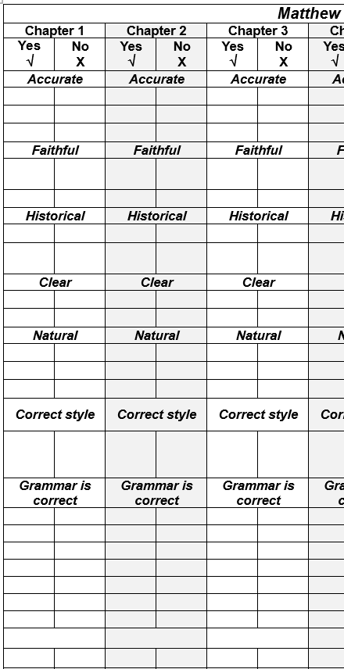
Try it

Slide 16
Try it
Matthew 1:18–25
How did it go?

Slide 17
7/2026

